Slide 1
Introduction to the Health for All Advocacy Toolkit
Created by the CSEM Secretariat
Presented by:

Slide 2
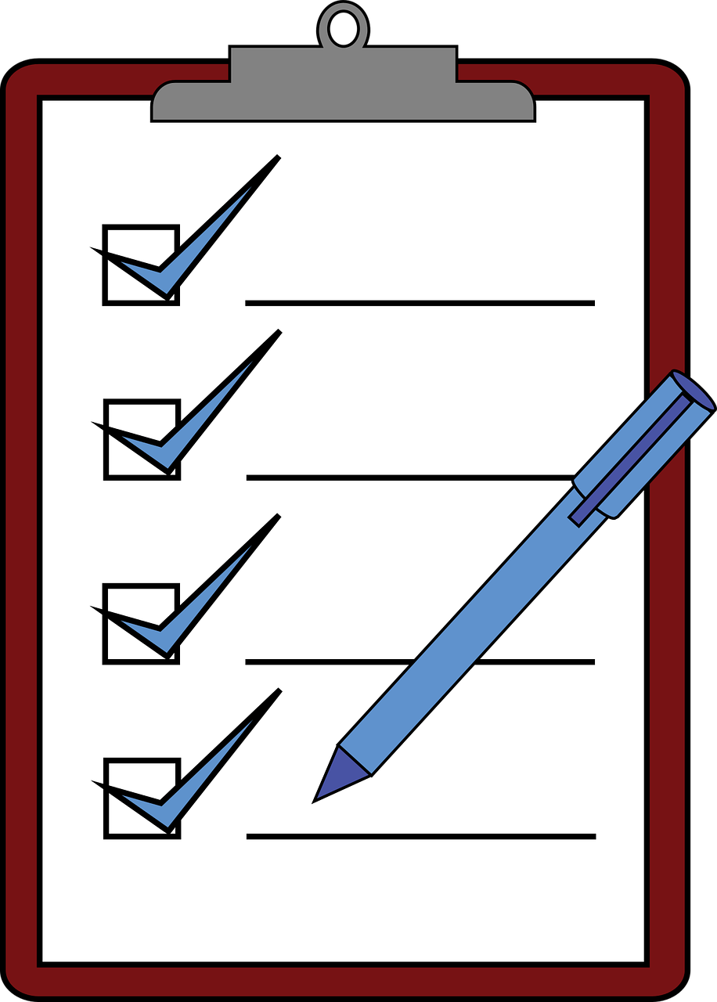
Presentation Outline
Overview of CSEM’s Health for All Advocacy Toolkit
Part 1: Introduction to Universal Health Coverage
Part 2: Why Civil Society Needs to Engage in Universal Health Coverage
Part 3: How to Participate
Resource Library
Using the Toolkit
Notes:
In this presentation, we will begin with an overview of the Health for All Advocacy Toolkit, developed by the Civil Society Engagement Mechanism for UHC2030 (also known as the CSEM). We will dig deeper into part 1 and part 2 of the toolkit, which presents some introductory information on universal health coverage (or UHC) and the advocacy space for UHC. We will then discuss a few advocacy resources, old and new, to integrate UHC work into your advocacy plans so that we can make progress toward health for all together. Lastly, we’ll take a quick look at the toolkit’s resource library and how it can be used.

Slide 3
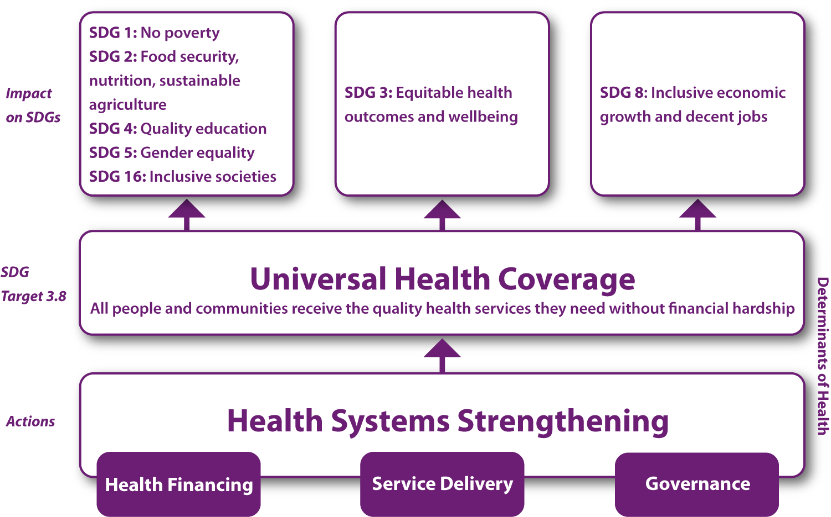
UHC: A Unifying Agenda
Progress toward universal health coverage (UHC) contributes to and benefits from the path toward other sustainable development goals.
Expanded access to quality health care reduces poverty, supports economic growth, improves nutrition, promotes education, and contributes to achieving gender equal and inclusive societies.
Notes:
If you are here today, you likely agree that universal health coverage is critical. Achieving UHC is inarguably a unifying objective in global health and sustainable development. This chart shows a snippet of how UHC, enshrined in Sustainable Development Goal 3, supports other SDGs - which are the global goals supported by the United Nations for a better world by 2030. There are of course even more linkages. We know the benefits of quality health care on individuals, their families, communities, and countries. Consider the COVID-19 pandemic and how we have been affected by not just the virus but by the response to it. This pandemic has reminded us about the foundational and cross-cutting nature of health - particularly of the impact of health systems on all aspects of society.

Slide 4
“Never doubt that a small group of thoughtful, committed citizens can change the world. Indeed, it is the only thing that ever has.”
— Margaret Mead
Notes:
There is undoubtedly a momentum for universal health coverage - perhaps even supported by the pandemic - but big changes do not come on their own. The fact is, UHC remains a deeply political agenda and to build this political will, we not only need the buy-in of health-focused stakeholders but also the support of decision-makers from across sectors - whether it’s economists and ministries of finance, education activists and leaders, agriculture experts, city planners, or the heads of small municipalities. Everyone has a role to play in the road toward UHC - which means all of us, civil society from all types of focus areas and backgrounds, have work to do. Together. As this quote from anthropologist Margaret Mead reminds, there is power in people - in mobilized communities.

Slide 5
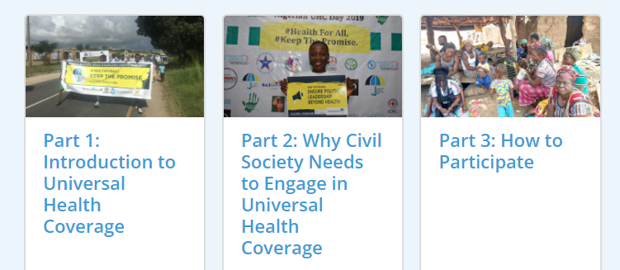
What is the Health for All Advocacy Toolkit?
Provides resources to kick-start UHC advocacy initiatives
Introduces primary UHC concepts and the role of civil society
Three parts:
Open Access:
www.csemonline.net/
Explore digital version or download PDFs
English, French, Spanish
versions now online
Notes:
The Health for All Advocacy Toolkit is a resource for civil society and community advocates, organizations and networks to begin or ramp up advocacy for UHC. This need not be a whole new venture but rather, can be used to compare your existing health or development related advocacy plans and see how they can support the global movement for universal health coverage. This toolkit introduces primary UHC concepts and describes some of the many roles civil society plays—not only in the local and national contexts but also in global health governance—to ensure no one is left behind.
It is available on csemonline.net. You are welcome to explore the digital versions, which includes a number of tools and templates. You can also download it and use as a printed tool for your own trainings or workshops. Today, we will take an introductory look at the contents and discuss some ways you may choose to use this resource.
Let’s look at part 1 and 2 together then go into breakout rooms to see the tools included in part 3.

Slide 6
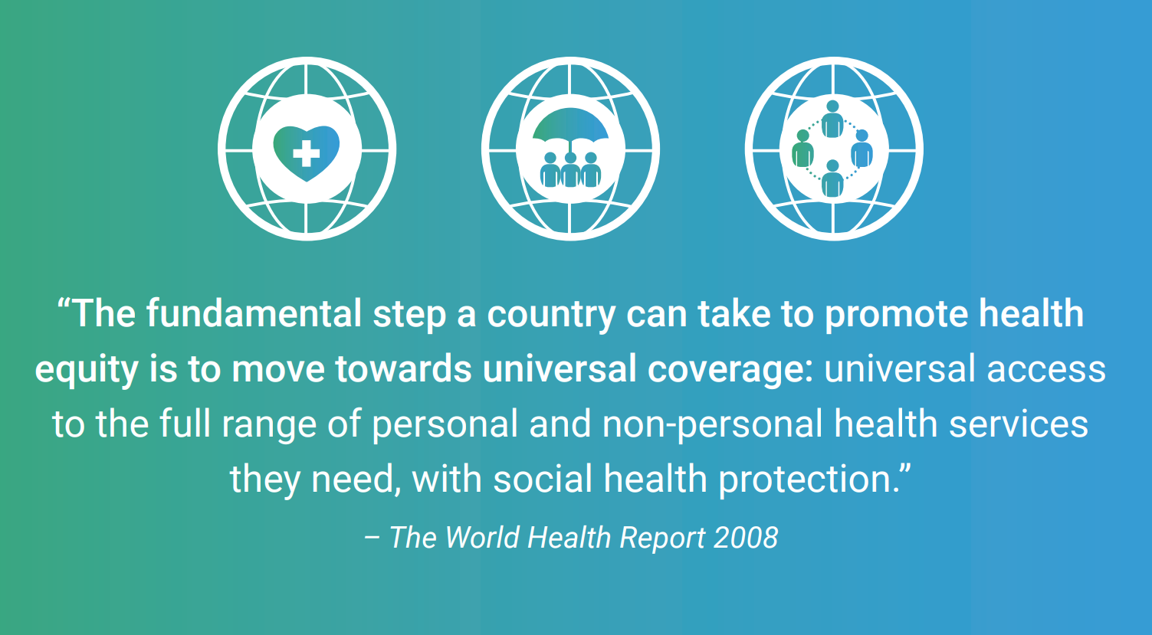
Why was the Toolkit developed?
In the lead up to the UN High Level Meeting on UHC in 2019, civil society and community representatives around the world asked for more knowledge and resources to advocate for UHC
CSEM survey sought to understand what would be most useful to support civil society’s UHC work
Notes:
The idea of creating the Health for All Advocacy Toolkit emerged in the lead up to the United Nations High-Level Meeting (HLM) on UHC in 2019. This was a key moment in the global advocacy path so far for UHC - we will come back to this in a few slides. To prepare for this HLM, various stakeholders in the UHC movement under the UHC2030 platform came together to develop the key advocacy asks they wanted member states to commit to and achieve. The CSEM, which is the civil society constituent of UHC2030, hosted advocacy sessions with civil society and communities at the country-level to identify UHC gaps and co-create messages so that they CSOs knew what to ask their governments.
Many of these civil society and community representatives asked for more knowledge and information about UHC, and about the global ecosystem around universal health coverage. CSEM then surveyed our members to understand the kinds of resources that would be most useful in supporting their work on UHC and used those results to shape this toolkit.
This toolkit was created from the needs that our civil society partners told us about and then refined based on their needs and expectations through the survey. It is not a catch-all of all the UHC information you will ever need but aims to be a ‘one-stop shop’ for key information and tools that can be used to build capacity, inspire and mobilise civil society advocacy for a wide social movement for UHC.

Slide 7
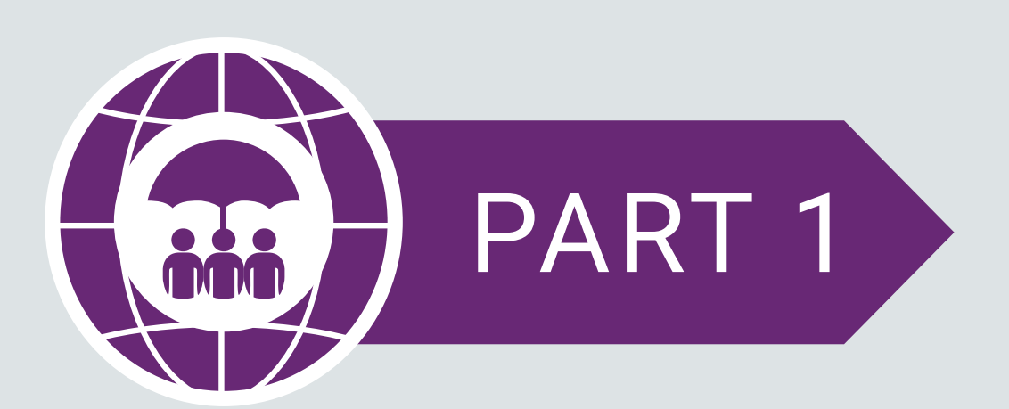
Introduction to UHC
What is Universal Health Coverage?
Why do we need it UHC?
UHC key concepts, actors, and milestones
Country examples of what UHC looks like in practice
Notes:
This first section of the toolkit provides a basic introduction to universal health coverage, how it works, why we need it, and an overview of the key concepts, actors and milestones to date. It is presented with a mixture of glossary terms, examples, key facts, and presents resources or publications users can use to dive deeper.

Slide 8
UHC: A Definition
MORE EQUITABLE
UHC is the aspiration that all people can obtain the health services they need, of good quality, without suffering financial hardship.
MORE ACCESSIBLE
MORE AFFORDABLE
Notes:
One important step for joint advocacy is having a shared understanding of the goal. Universal health coverage can be seen as a complex term, which further limits who engages on it and how. It is often presented as a technical concept but at the core, UHC has a simple definition. It is “the aspiration that all people can obtain the health services they need, of good quality, without suffering financial hardship.”
This statement has three elements that together capture our shared understanding: “all people” - meaning, healthcare must be more equitable. “can obtain the services they need” - as in, healthcare must be more accessible. “without financial hardship” - lastly, healthcare must be more affordable.
UHC is grounded in the values that all people have the right to health; that no one should fall into poverty to access health services; and that good health lifts people out of poverty.
Globally, there are tens of thousands of people advocating for a vast array of specific health issues, whether it’s mental health, NCDs, HIV, TB, malaria, and maternal health - and still more for the other SDGs. A joint understanding of these values and prioritization of UHC helps reduce fragmentation and competition among our initiatives, which further supports more government buy-in for progress on the SDGs.

Slide 9
The UHC Landscape and Key Milestones
- SDG 3
- G7 2016 & 2021
- G20 2017, 2019
- UN High Level Meeting on UHC (2019)
- WHA Resolutions 2019 & 2020
- Abuja Declaration (2001)
- African Health Strategy (2016-2030)
- Universal Health Coverage: Moving Towards Better Health Action Framework for the Western Pacific Region (2016)
- Strategy for Universal Access to Health and Universal Health Coverage (2014)
World Health Organization
UHC2030
Civil Society Engagement Mechanism for UHC2030
SDG3 Global Action Plan
World Bank
UHC Partnership
Access to COVID-19 Tools Accelerator (ACT-A)
Notes:
UHC is a central part of the SDG 3, which seeks to ensure health and well-being for all and UHC commitments have been made at global and regional levels, including at the G7/G20, WHA, AU – to name a few.
In terms of major actors in the UHC, there are several global and regional platforms that focus on UHC, including those listed here.

Slide 10
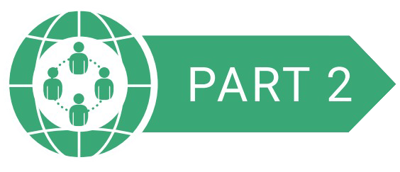
Why Civil Society Needs to Engage in UHC
The Role of Civil Society in UHC: Beyond Service Delivery
Stage by Stage: Civil Society Examples
Key Advocacy Messages
Notes:
Part 2 dives into why it's important for civil society to be a part of this global health advocacy. This section explores the critical role of civil society and communities in UHC design and implementation. It conveys the key advocacy messages that you can add to your campaigns.
CSOs are critical advocates for UHC, elevating the voices of community members and vulnerable populations to ensure that governments are developing, implementing and monitoring rights-based and human-centred UHC policies, strategies and approaches. Civil society has a vital role to play at every stage of the planning, implementation and monitoring.

Slide 11
Key Advocacy Messages
Leave no one behind
Ensuring people have the necessary access to equitable health services; they are informed of health policies; can input into their country’s health systems strengthening efforts.
Invest in health and provide social protection
Reducing out of pocket expenses
Engage meaningfully with civil society
Including CSOs in decision-making processes at all levels, to facilitate citizen-led monitoring of progress against outcomes towards universal health coverage
Support health workers
Ensuring availability, accessibility, and capacity of professionally trained health workers to deliver quality, people-centered health services
Notes:
While there are many policy problems and solutions civil society are well-placed to identify and address, this section focuses on four key advocacy areas or calls to action:
ensuring equity through national health plans and policies that leave no one behind, specifically prioritizing the most vulnerable populations first
increasing public financing for health so that countries are able to build strong, resilient health systems for UHC and work toward the eventual elimination of user fees and OOP
facilitating transparent and accountable health system governance by engaging communities and civil society in every step of decision-making
investing in the health workforce, including community health workers, in order to deliver quality, people-centered care.
We encourage all of you to use the toolkit and share it with your networks to develop a UHC advocacy plan that can incorporate specific health examples, to partner up with other health advocates to combine forces, and to use the toolkit to find ways of integrating UHC messaging into already ongoing mental health advocacy initiatives.

Slide 12
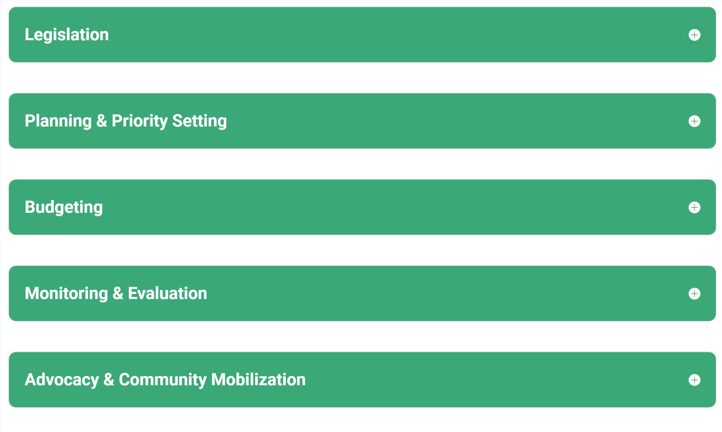
Stage by Stage: Civil Society Examples
Notes:
Civil society has important roles to play in all stages of the health policy making and implementation process. This part of the toolkit describes a few examples of CSO engagement from different parts of the world - from legislation and planning to budgeting and monitoring progress to UHC commitments. For example: - Citizen-based movement in Thailand ensured key provisions on accountability and voice were included in the National Health Security Act of 2002 - Participatory Budgeting Project in Democratic Republic of Congo has enabled rural and urban citizens to participate in budget process

Slide 13
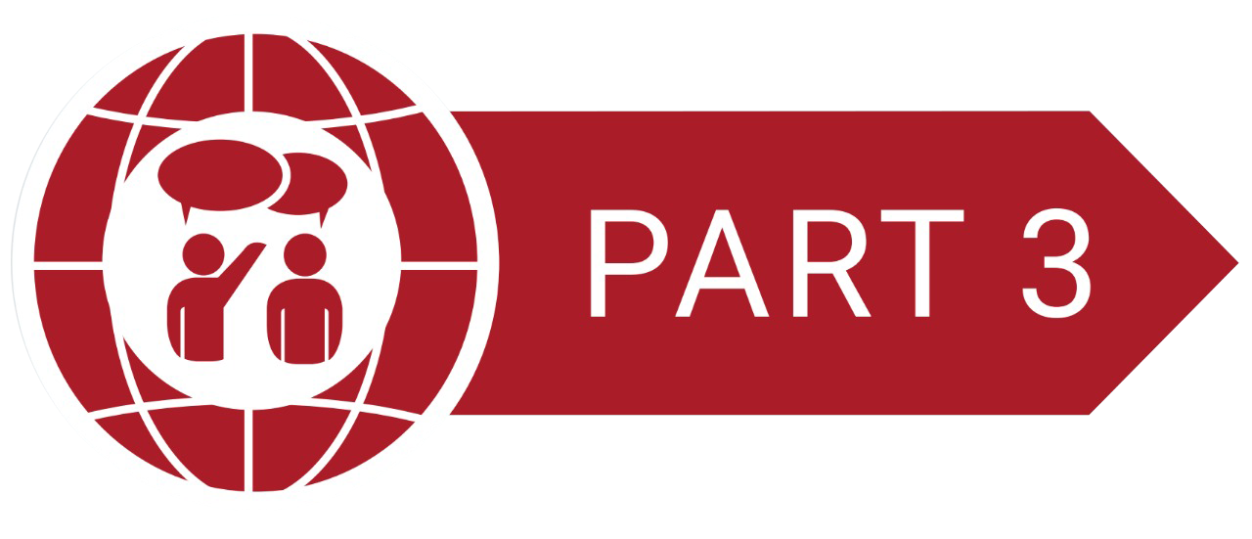
How to Participate
Step-by-step guidance on advocating for UHC
Essential processes for creating an advocacy action plan, determine budgets and measure progress
Practical tools and templates
Step 1/Define the problem: Where is your country on the road to UHC?
Step 2/Map targets: Who can steer things in a better direction?
Step 3/Map stakeholders: Who can join you on the road to UHC?
Step 4/Planning: Develop and Advocacy Action Plan
Notes:
Part 3 lays out steps in creating and implementing an advocacy plan. This includes defining where your country is on the road to UHC, and identifying the key challenges and bottlenecks. Then, the process of mapping advocacy targets and other stakeholders to collaborate with. Followed by developing advocacy asks and incorporating UHC key messages into ongoing advocacy work. Lastly, a budget template to explore the resources required, and a monitoring and evaluation template to measure the progress. We will walk through one of these steps in detail in a breakout room so that you can understand how the information is presented and get a glimpse of how you may want to present these tools to others.

Slide 14
Key Resources
many more!
Notes:
The last part of the toolkit is a resource library, which presents other complementary toolkits, additional learning materials and tools for their advocacy campaigns. This data portal, for example, can be found at UHC2030.org and can be used to explore how your country is doing on various UHC commitments. There is also this health budget toolkit released this year with specific tools to design trainings around understanding health budgets and conducting budget advocacy.

Slide 15
Using the Toolkit
LEARN:
Online Access
Discussion Forums
COLLABORATE:
Regional Channels
Global Engagement
SHARE:
Trainings
Best Practices
SHARE
COLLABORATE
LEARN
Notes:
Here are a few ideas on how to make the best use of this resource.
(1) Use it as a learning tool. As I mentioned earlier, this toolkit does not capture all the potential ways to advocate for UHC, but it is a springboard as you look to develop the content and advocacy plans for universal health coverage that apply most to your context and audience. It will remain a live resource and new information will be added to the online version as it becomes available. As you use the toolkit, share your feedback and comments with us! We will soon open discussion forums on the CSEM website related to the topics we discussed today as well as timely challenges and opportunities for UHC advocacy.
(2) Secondly, the toolkit can be a conversation starter, a way to collaborate with old and new partners. As you joined the workshop today, we had a question on the registration form about wanting to join a regional communications channel. If you answered yes, look out for some next steps to engage with other civil society organizations and community groups interested in UHC in the region. You can also join the CSEM to learn about opportunities to engage across regions. Stay in the meeting today to learn more about each other and meet some co-travellers in the road toward UHC.
(3) Lastly, we urge you to share it with others. You may already be familiar with all or some of the elements presented in this toolkit, but there are likely others in your network who aren’t. As we mentioned in the beginning of this presentation, we need a diverse range of voices raised for UHC. Consider: organizing a deep dive during a staff event, hosting a group of community advocates to walk through this toolkit, printing the PDF version to distribute at your next event. Please feel free to spread it widely. This presentation will be available to use for your trainings. We will also have calls for stories about how people are using this toolkit and sharing the information - join in and share best practices with others when the time comes.

Slide 16
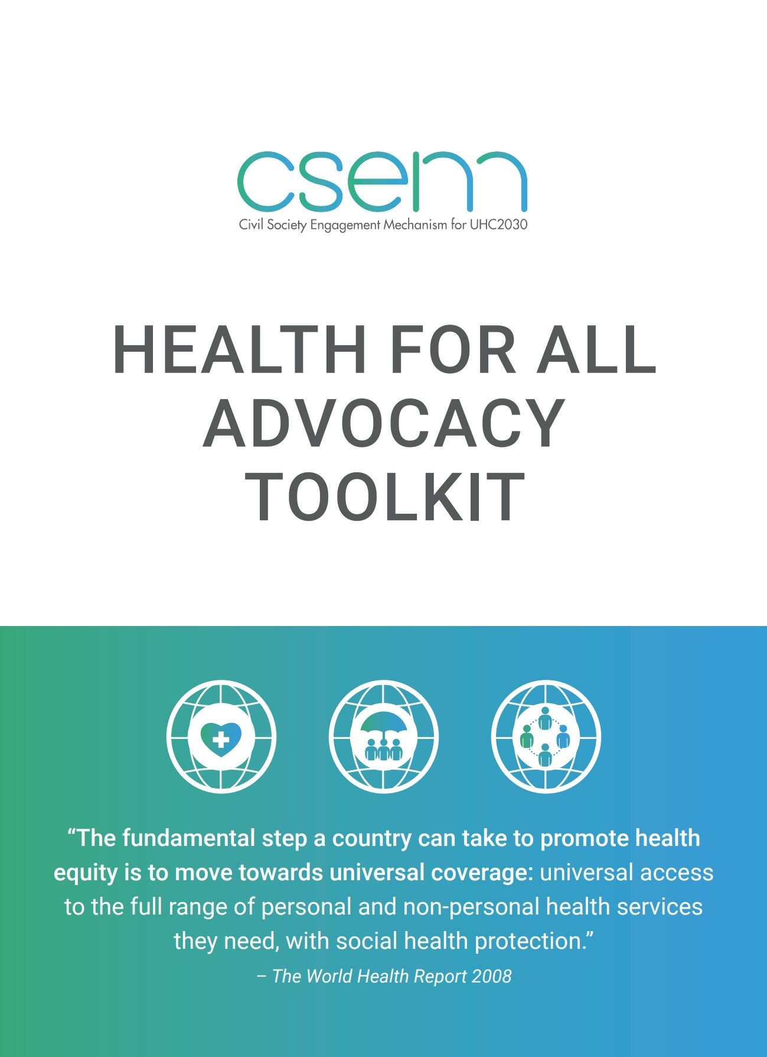
Thank you!
Download the Health for All Advcocacy Toolkit and join the CSEM at www.csemonline.net
The Civil Society Engagement Mechanism for UHC2030 (CSEM) is the civil society constituent of UHC2030 (formerly the International Health Partnership, IHP+), the global movement to build stronger health systems for UHC. Learn more about UHC2030 at www.uhc2030.org.
For questions, email: csem@msh.org
Notes:
*suggesting to move into discussions, Q&A, and small groups to look at an advocacy tool.

